Slide 1
7 Assessment for Development and Learning

Slide 2
Assessment for learning and development
…the process of gathering and analysing information about what children know, can do and understand. It is part of an ongoing cycle that includes planning, documenting and evaluating children’s learning
Source: Early Years Learning Framework for Australia (EYLF), DEEWR 2009, p. 17.

Slide 3
early childhood professionals …
Assess the progress of children’s learning and development, what children are ready to learn and how they can be supported
Use a range of assessment tools, processes and approaches to build on prior learning, avoid duplication and add value
Understand that families play a vital role in their children’s learning and development

Slide 4
early childhood professionals … (cont.)
Are aware of the health and wellbeing of the family when planning for the child’s learning and development
Assess children’s learning in ways that:
  inform their practice
  include children’s views of their own learning
  are authentic and responsive to how children demonstrate their learning and development

Slide 5
early childhood professionals … (cont.)
  draw on families’ perspectives, knowledge, experiences and expectations
  consider children in the context of their families and provide support to families when necessary
  value the culturally specific knowledge embedded within communities about children’s learning and development

Slide 6
early childhood professionals … (cont.)
  are transparent and objective, and provide families with information about their children’s learning and development, and about what they can do to further support their children
  gather and analyse information from a wide range of sources to help them assess and plan effectively
  provide the best possible advice and guidance to children and their families

Slide 7
Examples of strategies and tools
Maternal and child health nurses use key ages and stages framework and parents’ evaluation of developmental status (PEDS)
Educators in education and care settings use anecdotal records
Teachers in the early years of school use english online interview
Early childhood intervention professionals use play-based assessment

Slide 8
Three common kinds of assessment
Assessment of learning and development
Assessment as learning and development
Assessment for learning and development
All types of assessment strategies contribute to assessment for learning and development

Slide 9
Assessment of learning and development
Summarises what children know, understand and can do at a particular point in time
Includes large-scale, population assessment strategies such as the National Assessment Program - Literacy and Numeracy (NAPLAN) and the Australian Early Development Index
A transition learning and development statement is also an example of a summary statement which can be helpful when there are shared concerns about a child’s learning and development

Slide 10
Assessment as learning and development
Occurs when professionals involve children actively in assessing their learning and development
By monitoring and thinking about what and how they learnt with adults and peers, children see themselves as learners and can use this information to learn more effectively and take more control over their learning
Assessment as learning recognises that children are competent and capable learners from birth
When professionals ask children to explain how they learnt something or who helped them to learn, they are using assessment as a tool to support learning

Slide 11
Assessment for learning and development
Is a continuous process of finding out what children know, understand, and can do in order to plan what next, building on previous learning and supporting new learning

Slide 12
Assessing for learning and development
Professionals analyse and interpret the information they collect through critical reflection and discussion with colleagues, families, children and other professionals using:
  knowledge of child development and learning
  deep understanding of the Learning and Development Outcomes including dispositions for learning
  knowledge of the child’s social and cultural background (the child in context)
  families’ understanding about their children’s learning and development at home and in the local community
  information from other professionals involved with the child

Slide 13
Why assess?
Assessment allows professionals to:
  use/interpret evidence to identify what children already know, can do and are ready to learn
  monitor children’s progress and achievements over time
  make decisions about experiences and opportunities to advance learning and development in response to individual children’s strengths, abilities, interests and needs
  identify children who may benefit from additional or specialised support and what these supports should be

Slide 14
Why assess? (cont.)
Assessment allows professionals to:
  communicate and collaborate with children, families and other professionals about children’s learning and development
  work in partnership with families and children to plan meaningful learning experiences
  recognise that what professionals plan, do, say and provide contributes to every child’s learning
  evaluate and improve curriculum decision-making so that what is planned has rigour – that is it is meaningful and worth children knowing and doing

Slide 15
Empowering children through assessment
Children’s awareness of progress
Meta-cognition and its link to learning dispositions
Professionals modelling and talking
Assessment as a dynamic process

Slide 16
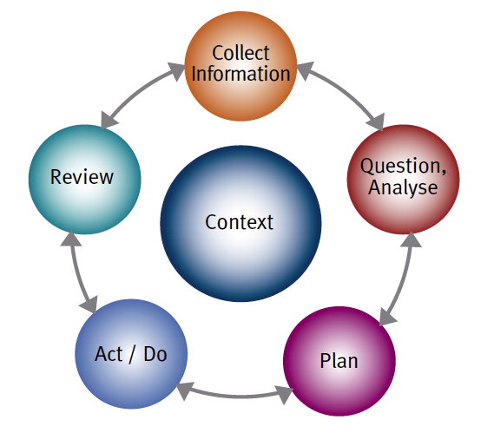
Early Years Planning Cycle

Slide 17
Collect information
Assessment requires professionals to collect information about children’s learning and development using a range of strategies and tools including (but not limited to):
  observations (for example, running records, anecdotal records)
  conversations and interviews with children
  samples of children’s work
  checklists
  rating scales

Slide 18
Collect information (cont.)
  video or audio recordings of children’s conversations or play
  webs of children’s ideas about a topic from initial discussions and throughout a project
  photographs
  event and time sampling
  tests
  conversations with families, colleagues and other professionals

Slide 19
Question/analyse
What is the child learning currently?
What is the child showing me that they have learnt?
What is the child ready to learn? How do you know that?
What gaps are there in the learning? Is there learning you expected to observe that is not evident? Why might it be missing?

Slide 20
Question/analyse (cont.)
Who or what is helping the learning?
What is interfering with the learning?
At what stage is the learning – beginning, emerging, exploratory, practising, consolidating, extending, confident, mastery?
What learning disposition(s) is the child using?
What is the purpose of the learning?

Slide 21
Plan
Decide what to do next based on your analysis and discussions with others and on the understanding that the child’s experience across the entire session or day matters and needs to be planned for

Slide 22
Act and do
Implement plans using intentional strategies to ensure children’s learning progresses

Slide 23
Review
Reflect on what works well and what doesn’t (in terms of children’s learning and your professional practice) and how children are being supported to learn across all the learning and development outcomes
Consider other services and supports you could link with to provide better support to a child and their family

Slide 24
Effective assessment
Uses authentic and appropriate approaches
Provides an holistic understanding of each child’s learning and development
Is objective and non-judgemental
Is ongoing, measuring progress over time

Slide 25
Effective assessment (cont.)
Recognises cultural diversity and perspectives
Incorporates children’s views
Incorporates families’ and other professionals’ views
Incorporates and uses assessment of all aspects of the curriculum or program

Slide 26
Authentic assessments take place …
In environments that are familiar and natural to children
When children are comfortable
When children can engage with experiences, materials and equipment that interest them
In everyday experiences

Slide 27
Authentic assessments take place when children…
Have conversations with other children and with adults
Participate in daily routine experiences such as mealtimes
Engage in child-directed play indoors and outdoors
Take part in adult-led experiences, such as learning a new song
Are on their own
Interact with others
Face challenges

Slide 28
assessments need to be…
Be both informal and more formal (e.g. observations or a standardised assessment tool)
Occur in a number of different ways
Take place in different contexts and settings (e.g. during arrival time and in outdoor play experiences)
Be culturally appropriate
Use a variety of tools or strategies appropriate for the purpose

Slide 29
Holistic assessment in practice
Involves exploring and assessing different aspects of children’s learning and development in different contexts, environments and relationships
Helps professionals gain a clear and comprehensive picture of children’s learning and development so they can plan appropriately across all the Learning and Development Outcomes

Slide 30
objective assessment in practice
Involves exploring and assessing different aspects of children’s learning and development in different contexts, environments and relationships
Helps professionals gain a clear and comprehensive picture of children’s learning and development so they can plan appropriately across all the Learning and Development Outcomes

Slide 31
Children’s learning and ongoing assessment
Behaviour varies from day-to-day and situation to situation
Learning is not linear or a step-by-step process
Earning requires them to actively make sense of what they experience, hear, see and do
Learning is competent from birth

Slide 32
ongoing assessment over time
Most informative assessments take place continually over a period of time with a range of assessment tools or strategies
Distance travelled may include major changes or small steps in learning, all of which should be recognised and used to inform planning what next for a child

Slide 33
Culturally and linguistically appropriate assessment in practice
Assessment needs to take into account how family, cultural and language backgrounds influence the knowledge and skills that children acquire and the type of learning opportunities they have

Slide 34
Incorporating children’s views
The VEYLDF promotes the idea that learning is most effective when children are active agents or participants in and contributors to their learning and the assessment of their learning
Children benefit from getting feedback from professionals and other children about their learning and development

Slide 35
Creating Shared, sustained interactions and conversations with children
Ask authentic open-ended questions
Encourage children to ask questions
Make meaningful comments
Offer explanations at times and also encourage children to explain
Promote collaborative problem-solving

Slide 36
Creating Shared, sustained interactions and conversations with children (cont.)
Clarify concepts or ideas
Collaborate to create new ideas together (co-construction)
Make connections with previous learning
Extend conversations
Discuss children’s theories and hypotheses

Slide 37
families’ views
Play an essential role in their children’s learning and development
Are a valuable source of information about their children
Can give information about their children’s past experiences, cultural background, temperament, interests, abilities, behaviour and learning in different settings

Slide 38
Evaluation of curriculum or program components
Professionals not only assess children’s learning, they also evaluate or assess their program or curriculum (environments, resources, routines, experiences, events, interactions, conversations) and how it supports or limits children’s learning and development

